Slide 1
Gene Expression, Gene Regulation and Phenotypic Expression

Slide 2
What you need to complete
Read Chapter 4 pages 86 - 90 Biology WA ATAR Units 3 & 4
Answer Biology WA ATAR Question Sets
Set 4.1 Q 1 – 5
Set 4.2 Q 3 – 4
Biozone Activities
114 Eukaryote Chromosome Structure
195 DNA Methylation

Slide 3
Syllabus:
the phenotypic expression of genes depends on the interaction of genes and the environment
Explain, using examples how the phenotypic expression of a gene can depend on interactions with the environment
Essential Question:

Slide 4
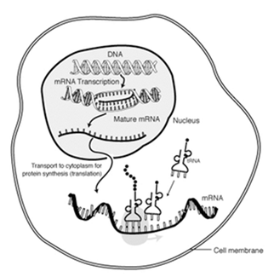
Revision: Describe protein synthesis
To understand gene expression you need to have a firm grasp of protein synthesis.
Lets recap this quickly…
Label the diagram to summarize protein synthesis in a eukaryotic cell
Which enzyme is used to break hydrogen bonds between DNA bases and synthesis mRNA?
What is the name of the region of DNA that the enzyme can bind to?
What are the 2 stages of protein synthesis & where do they occur

Slide 5
Revision: What is gene expression?
Match the sentences
Gene expression is when a gene is used….
When a gene is being expressed, it is going through the process of…
Gene expression is regulated because…
All our body cells contain…
During the early development of an organism…

Slide 6
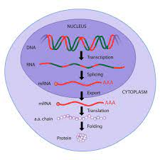
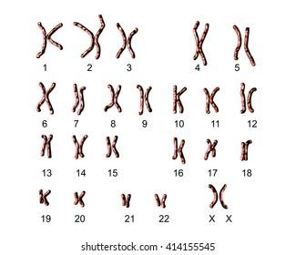
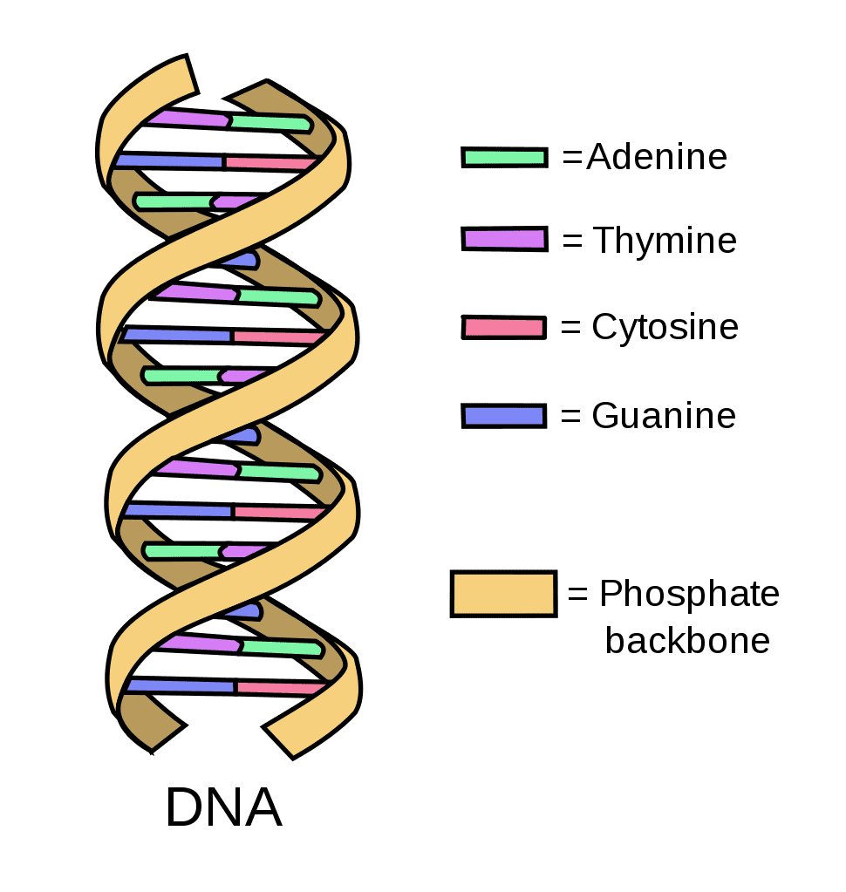
Revision: What is gene expression?
Protein Synthesis
Genome
Organism

Slide 7
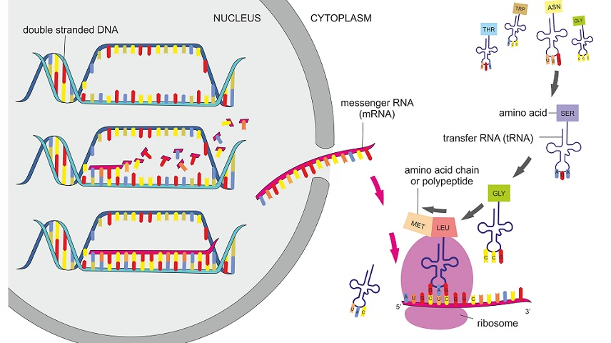
Topic Question 1: Outline the four main steps in gene expression
Protein Synthesis
This is a question from the 2021 ATAR exam
DNA is transcribed into a single stranded mRNA molecule which is complementary to the template DNA strand
Introns are removed from immature mRNA (or pre-mRNA) so only the exons remain. The exons are the coding sequences
mRNA moves out of the nucleus via the nuclear pore into the cytoplasm and binds to a ribosome
mRNA interacts with tRNA to translate genetic code into a polypeptide chain
Its just the steps of protein synthesis

Slide 8
Topic Question 2: Describe phenotypic expression of a gene
Genes carry a set of instructions for how to make a protein. When the gene is read, transcribed and translated into a protein, the gene is said to be expressed.
By coding for proteins, genes determine important facets of biological structure and function.
These observable traits are known as the phenotype.

Slide 9
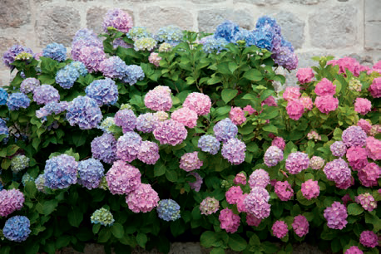
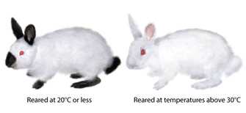
Topic Question 2: Describe phenotypic expression of a gene
Genes cannot dictate the structure of an organism by themselves.
The other crucial component in the formula is the environment.
Twins may have the same gene and protein for a trait, but the trait may look different in the two individuals because the environment can influence the final phenotype.
There is a diversity of genetic and phenotypic traits within and between populations known as variation.

Slide 10
Topic Question 3: What are the main mechanisms for genotypic and phenotypic variation
Phenotypic expression of genes
Sources of variation
Mutation
Sexual reproduction processes
Change in genotype
Environmental factors
Internal (e.g. presence or absence of hormones) and external environmental factors (e.g. temperature and light intensity)
Epigenetics
Chemicals that can switch genes on or off (only changes phenotypes, not genotypes)
Change in phenotype

Slide 11
Topic Question 4: What is gene regulation?
Gene regulation is the process of controlling which genes in a cell’s genome (all the genetic material of a cell/organism) are expressed (used to make a functional product such as a protein)
It is how a cell controls which genes, out of the many genes in its genome, are "turned on" (expressed).
gene regulation is why each cell type in your body has a different set of active genes – despite the fact that almost all the cells of your body contain the exact same DNA.
These different patterns of gene expression cause your various cell types to have different sets of proteins, making each cell type uniquely specialized to do its job.
https://www.khanacademy.org/science/biology/gene-regulation/gene-regulation-in-eukaryotes/a/overview-of-eukaryotic-gene-regulation

Slide 12
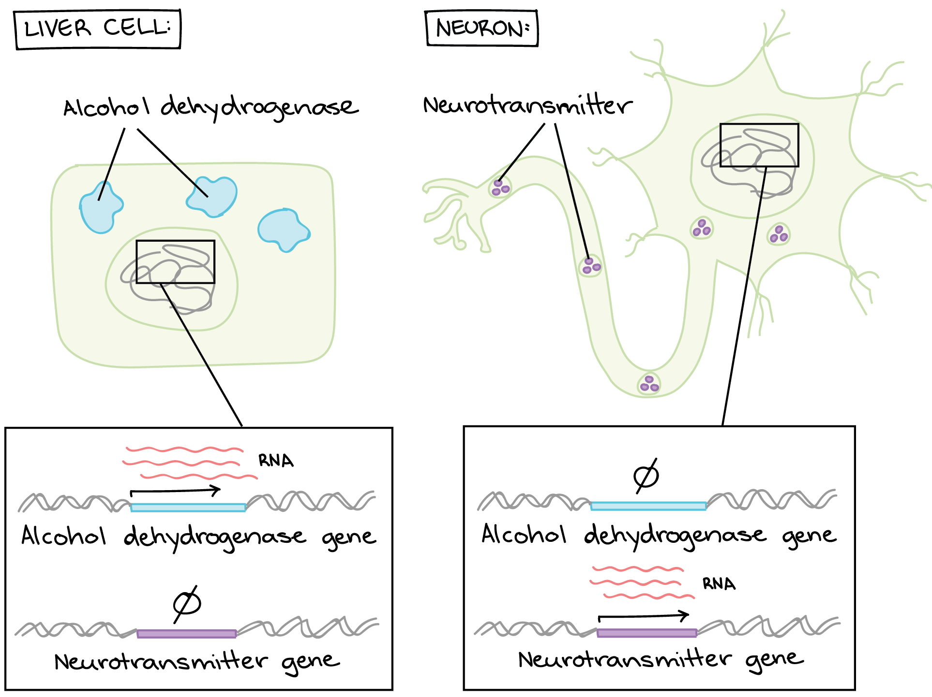
Topic Question 5: Give an example of gene regulation?
https://www.khanacademy.org/science/biology/gene-regulation/gene-regulation-in-eukaryotes/a/overview-of-eukaryotic-gene-regulation

Slide 13
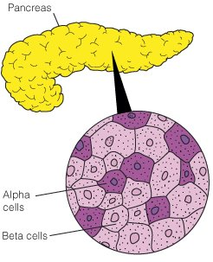
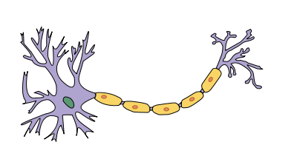
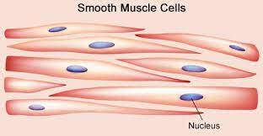
Topic Question 5: Give an example of gene regulation?
A scientist analysed the gene expression in four different cell types
They found increased expression in particular genes that code for the proteins shown below
For each protein, determine the specialized cell type and then draw a line to match your answer to the correct cell type
Actin & myosin
Dopamine
Antibodies
Insulin

Slide 14
Topic Question 6: Explain, using examples how the phenotypic expression of a gene can depend on interactions with the environment
External environment
expression of some genes varies with external environment
Temperature, availability of food or light exposure can determine whether or not a gene is expressed
Examples:
expression of genes that determine sex in reptiles is affected by temperature (temperature dependent sex determination)

Slide 15
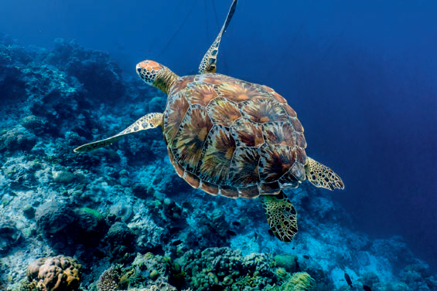
Topic Question 6: Explain, using examples how the phenotypic expression of a gene can depend on interactions with the environment
Examples:
expression of genes that determine sex in reptiles is affected by temperature (temperature dependent sex determination)

Slide 16
Topic Question 6: Explain, using examples how the phenotypic expression of a gene can depend on interactions with the environment
Body condition
expression of some genes varies with body conditions, internal environment or hormones
hormones regulate expression of genes that are expressed only in one sex or more strongly in one sex
For example:
genes needed for lactation are expressed only in female mammals

Slide 17
Topic Question 6: Explain, using examples how the phenotypic expression of a gene can depend on interactions with the environment
Environmental influence on gene products
gene products/proteins/enzymes of some genes are affected by external environment because the environment may prevent some gene products/proteins/enzymes from functioning
enzymes may not function at high/low temperatures/pHs

Slide 18
Topic Question 6: Explain, using examples how the phenotypic expression of a gene can depend on interactions with the environment
For example:
Himalayan rabbits are white except for black extremities because the enzyme needed to produce black fur only functions at low temperatures

Slide 19
Topic Question 6: Explain, using examples how the phenotypic expression of a gene can depend on interactions with the environment
Examples:
The range of colours in hydrangea flowers can be traced back to the pH in the soil.
A more acidic soil is conducive to blue flowers.
The pH does not change the genome because the genotype does not change. It is the interaction of the environment with either the gene or the protein that determines the flower colour in hydrangeas.

Slide 21
Topic Question 6: Explain, using examples how the phenotypic expression of a gene can depend on interactions with the environment
Chemical changes to DNA
environment can result in chemical changes to DNA that affect gene expression (called epigenetics)
https://www.youtube.com/watch?v=MD3Fc0XOjWk

Slide 22
Topic Question 6: Explain, using examples how the phenotypic expression of a gene can depend on interactions with the environment
For example
Bees are a great example of epigenetics in action.
The bees in an entire hive all have the exact same DNA- the drones, worker bees, and Queen are all clones.
If they are all clones, then why do they look different and have different jobs?
The answer is epigenetics and "royal jelly".
https://www.youtube.com/watch?v=2uiB8Fg8iRg

Slide 23
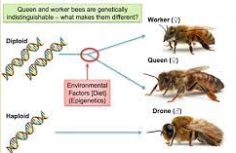

Slide 24
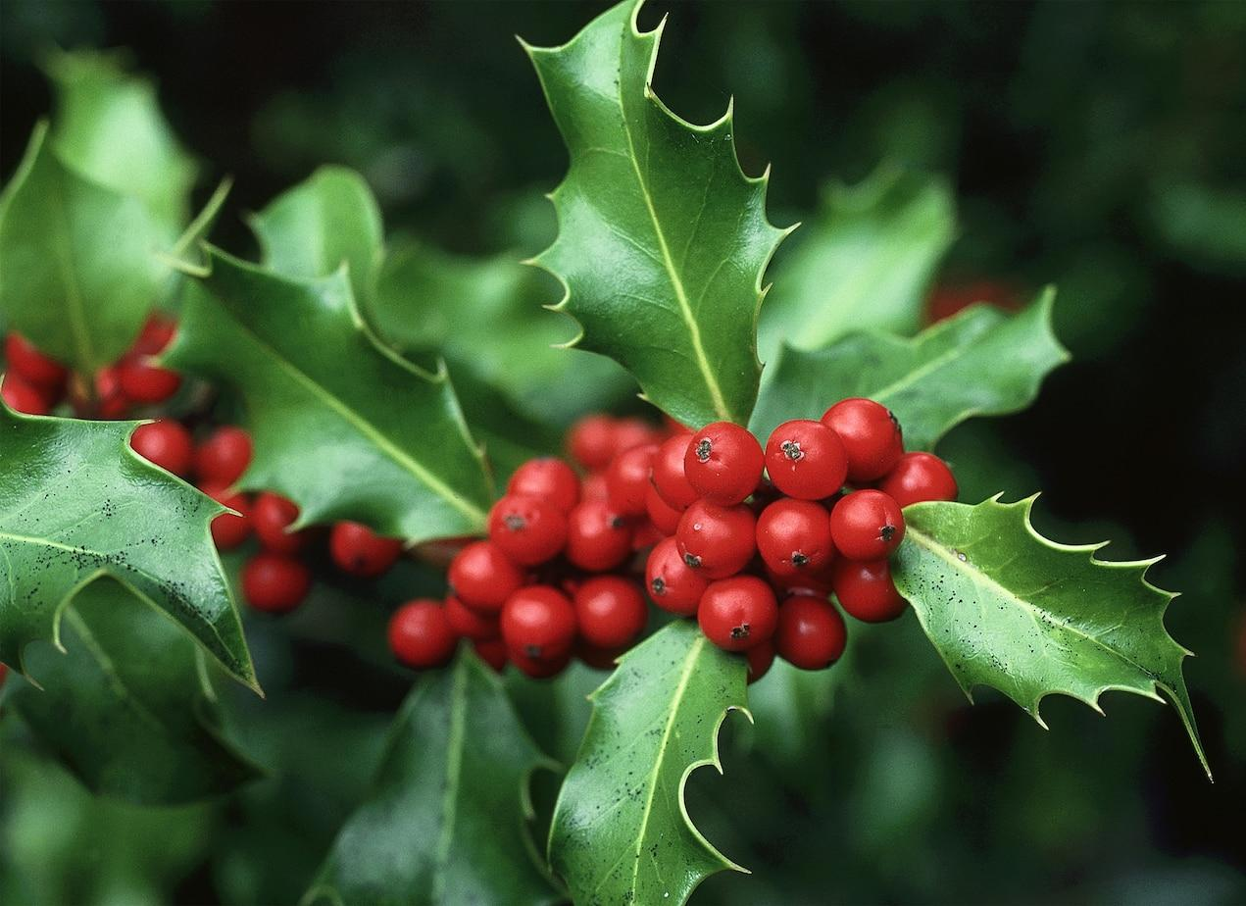
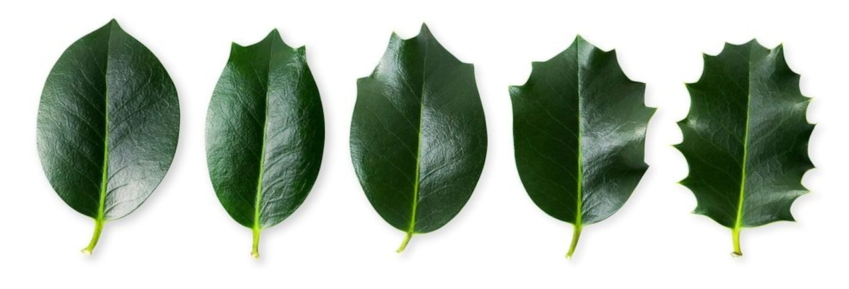
Hollies Get Prickly for a Reason
All of the leaves on a tree are genetic twins and share exactly the same DNA sequence.
"In holly, what we found is that the DNA of prickly leaves was significantly less methylated than prickless leaves, and from this we inferred that methylation changes are ultimately responsible for leaf shape changes," Herrera said.
"The novelty of our study is that we show that these well-known changes in leaf type are associated with differences in DNA methylation patterns, that is, epigenetic changes that do not depend on variation in the sequence of DNA.” https://www.nationalgeographic.com/science/article/121220-holly-leaves-prickly-plants-science
Below are five holly leaves from the same tree.

Slide 25
Topic Question 6: Explain, using examples how the phenotypic expression of a gene can depend on interactions with the environment
Chromatin accessibility. The structure of chromatin (DNA and its organizing proteins) can be regulated. More open or “relaxed” chromatin makes a gene more available for transcription.
For a section of DNA to be active the nucleosomes in the region of the gene must be far apart
DNA methylation and Histone acetylation are examples of epigenetic control of gene expression where the chromatin accessibility is regulated – You will read information on these chemical changes to DNA

Slide 26
Instructions
Topic Question 6: Explain, using examples how the phenotypic expression of a gene can depend on interactions with the environment
Read the information to understand DNA methylation & Histone acetylation
Highlight text using two different colours. Use one colour to highlight new vocabulary and the other colour for new information
Complete the labels on the picture
In the Summary box, decribe DNA methylation in your own words
In the Impact box, state if the gene is expressed or not. Then colour the lightbulb in yellow to show if DNA methylation enhances gene expression or shade the light bulb in grey is gene expression is reduced

Slide 27
Therefore
Histone acetylation enhances gene expression
DNA methylation reduces gene expression
https://www.youtube.com/watch?v=_aAhcNjmvhc

